Slide 1
CAMPUS RECRUITMENT SYSTEM
- Nikhil Yerra

Slide 2
INTRODUCTION
A college campus recruitment system consists of a student login, company login and an admin login.
The software system allows the students to create their profiles and upload all their details including their marks onto the system.
The system also consists of a company login where various companies visiting the college can view a list of students in that college and also their respective resumes.
The software system allows students to view a list of companies who have posted for vacancy.
The admin has overall rights over the system and can moderate and delete any details not pertaining to college placement rules.
The system handles student as well as company data and efficiently displays all this data to respective sides.

Slide 3
TODAY’S SCINEARIO
Now a days, most of the companies are having websites and they posting their vacancies through their own websites.
They are paying for famous job portal websites and also they are posting their vacancies through social media to get right candidates
Companies are wasting their time and money to find right candidates.

Slide 4
Objective of project
Development of web based campus recruitment management software system for universities and software companies

Slide 5
Limitations of project
Time was the biggest limitation. The project requires a thorough study which requires a considerable amount of time.
The study is based on both primary as well as secondary data

Slide 6
Existing System
Before creating this website, all students to send their resumes or information through postal mails.
Here there may occur errors in the process .The administration faces the problems to collect all information.
Administration has to send requirements information to different consultants and students.

Slide 7
Drawbacks in existing system
The system is manual
Time consuming process to search or find the records
Needs more effort
No accuracy in final results

Slide 8
Proposed System
The proposed system is online system there will be no need of putting up notice or emailing every student about the company coming in college.
The students can keep updated themselves through this software and can register online
The company can view all student detail and system can shortlist students according to their criteria
There is admin login that can view and manage both students and company’s account and also can put up notifications.

Slide 9
Software and Hardware requirements
Software requirements:
Operating System : Win 10
Technology : Jdk 1 .7
Front end : Html, JavaScript, CSS,JSP
Web Server : Apache Tomcat 7
Database : My SQL 5.0
Hardware requirements:
System : Pentium IV 2.4 GHz
Hard Disk : 160 GB.
Monitor : 15 VGA Color
Ram : 4GB

Slide 10
Functional requirements
Company:
Company can register with his self with a portal.
Admin can maintain the all the information about the student and companies information.
Admin is storage repository and can also modify or delete the information
Company can login and track the students information.
Companies can interact with students.
We build the global data where company can access the information

Slide 11
Student:
Student can sign up his/ her self in a student portal.
Student update their details and academic records.
Student can interact with companies
We build the global database where student can search and apply for the jobs

Slide 12
Admin:
Admin can maintain the all the information about the student and companies information.
Admin is storage repository and can also modify or delete the information

Slide 13
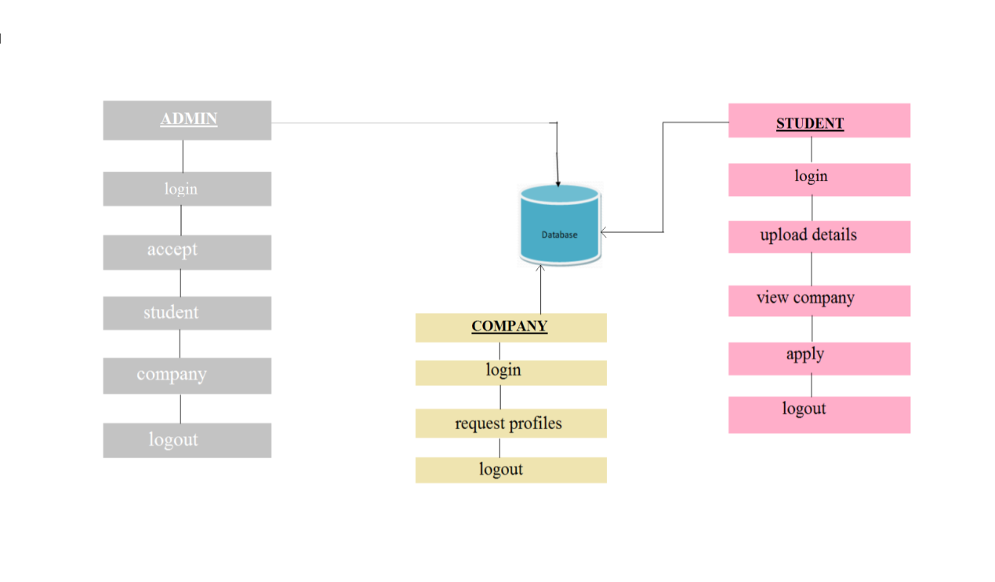
System Architecture

Slide 14
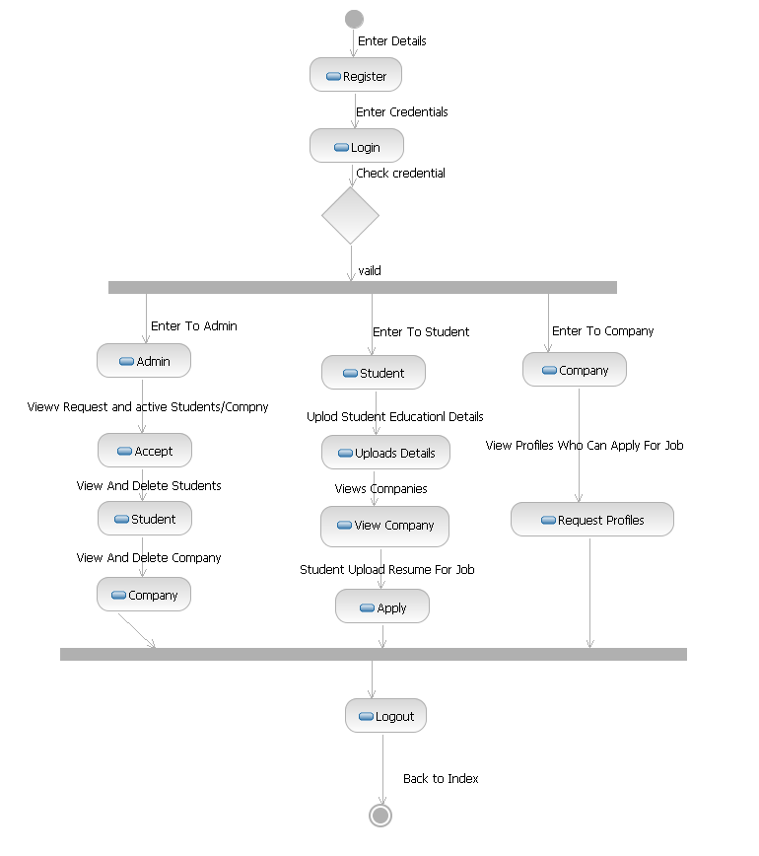
Activity Diagram

Slide 15
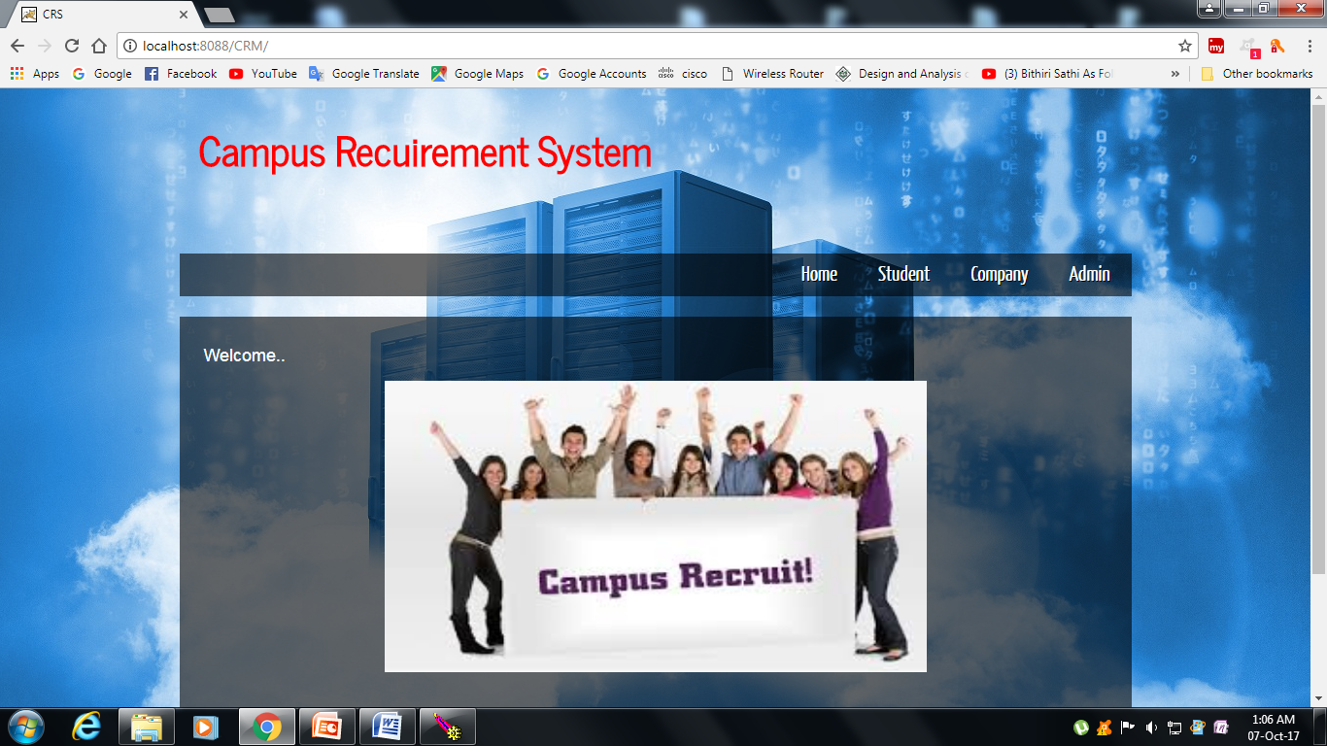
Output Screens

Slide 16
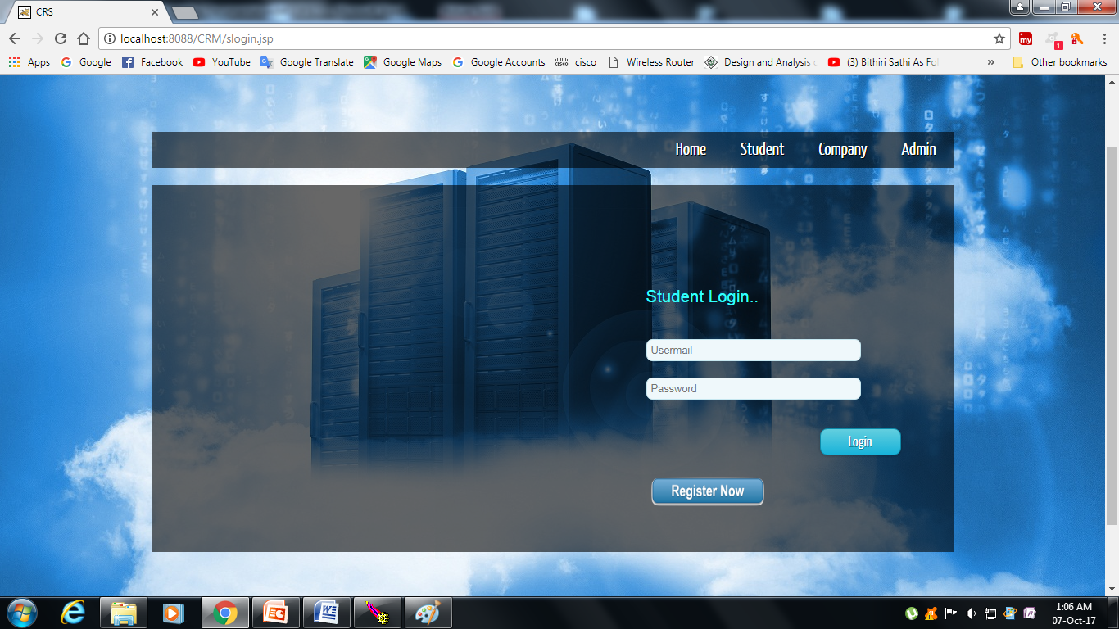
Student login page:

Slide 17
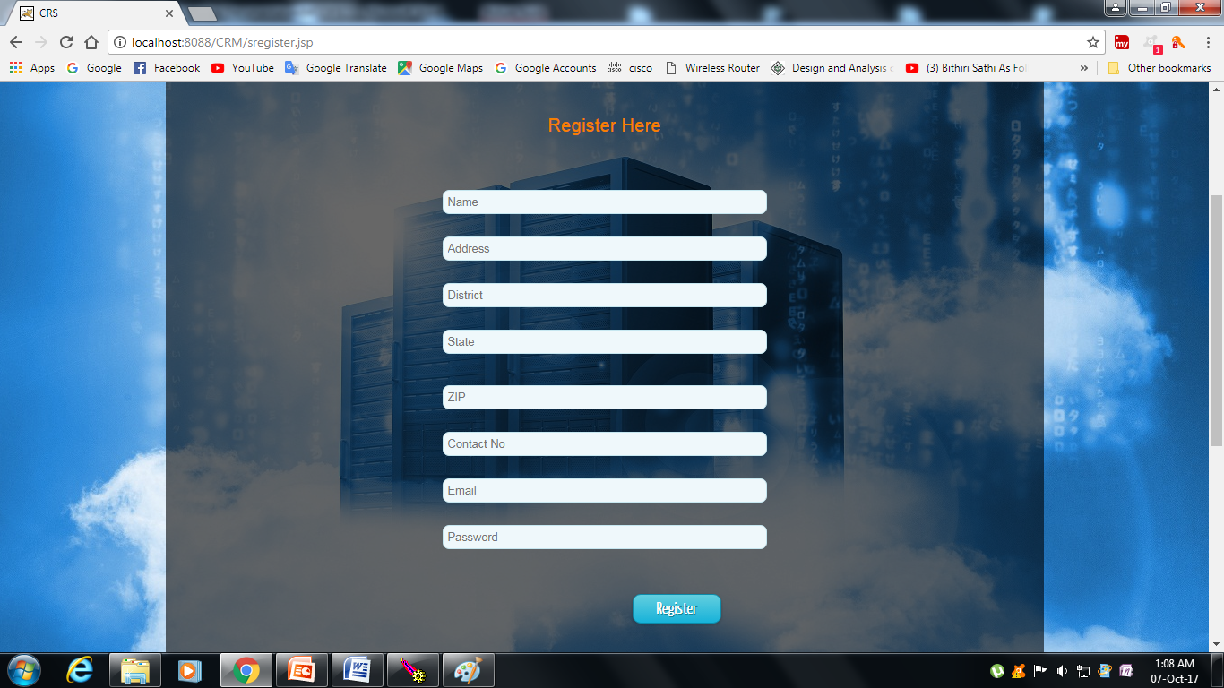
Student register page:

Slide 18
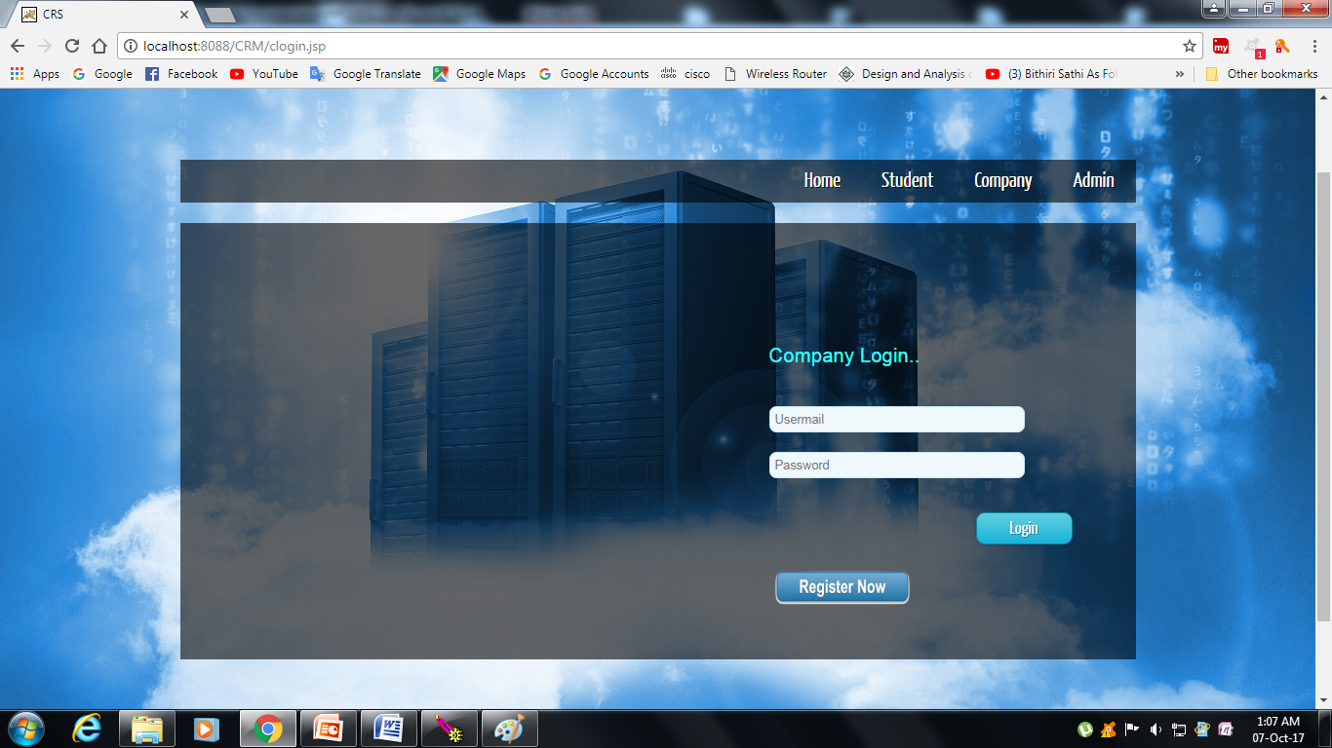
Company login page:

Slide 19
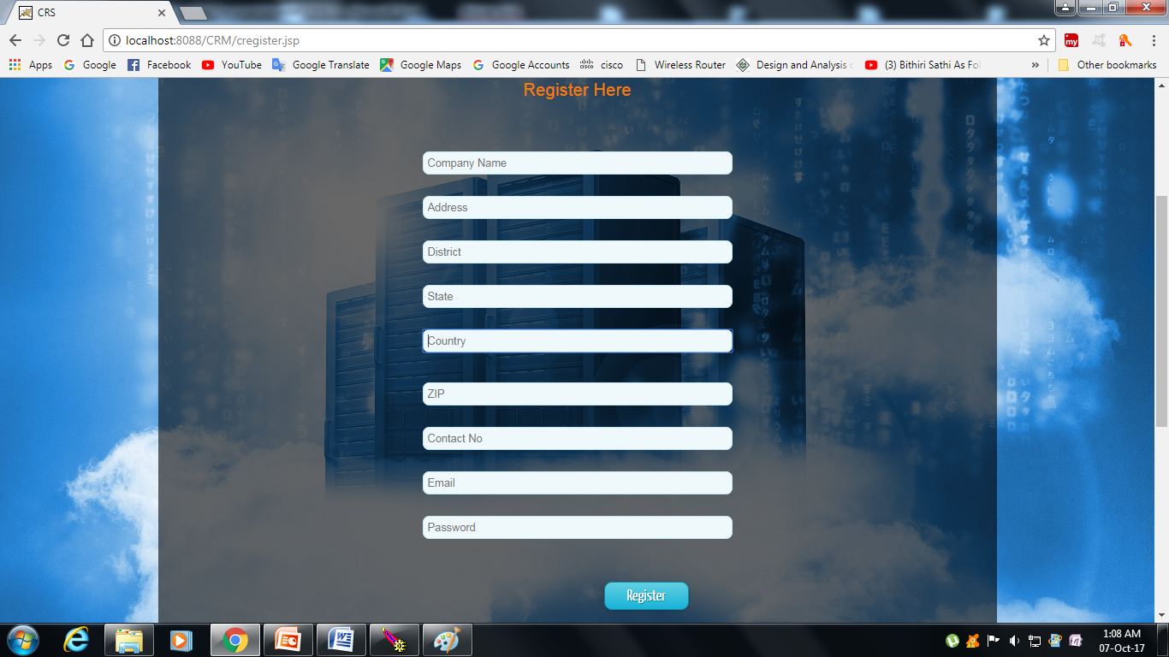
Company register page:

Slide 20
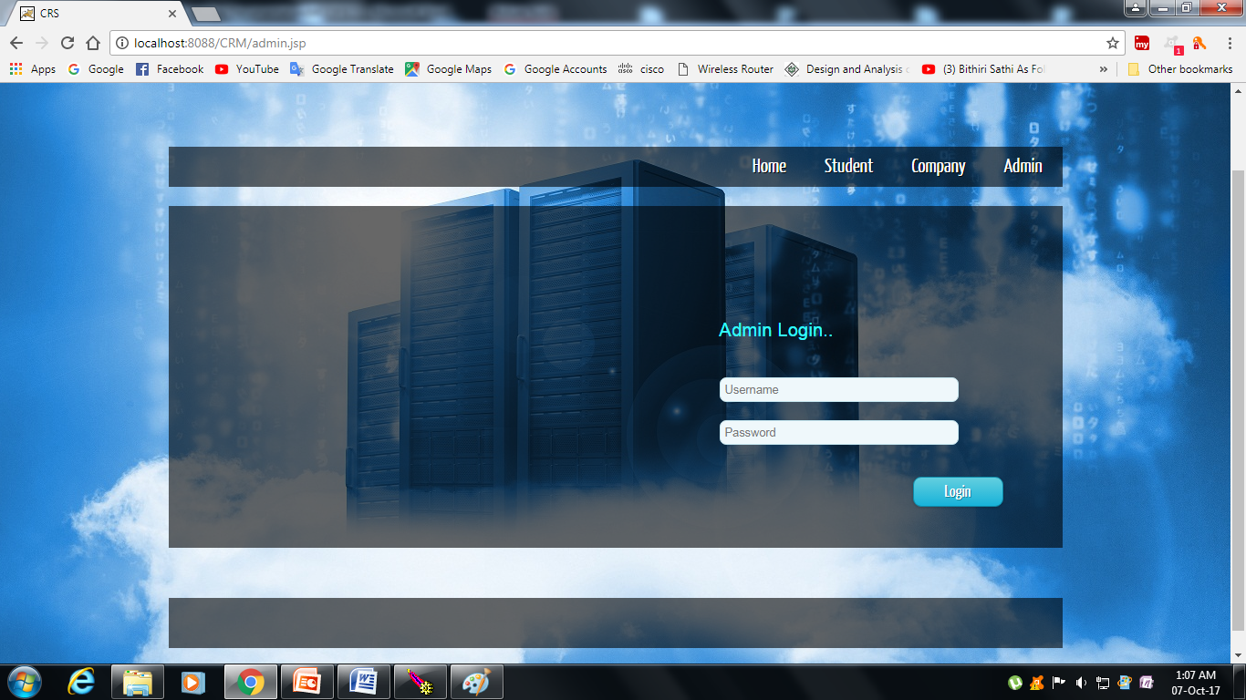
Admin login page:

Slide 21
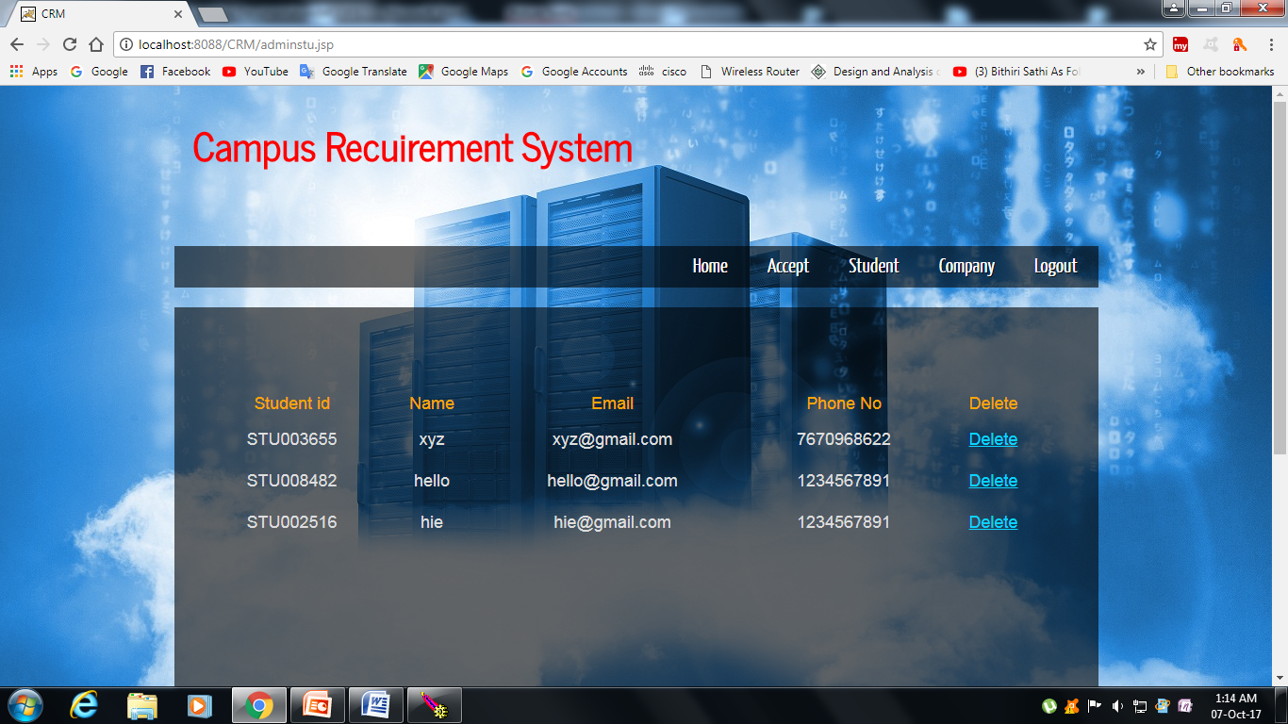
Admin student page:

Slide 22
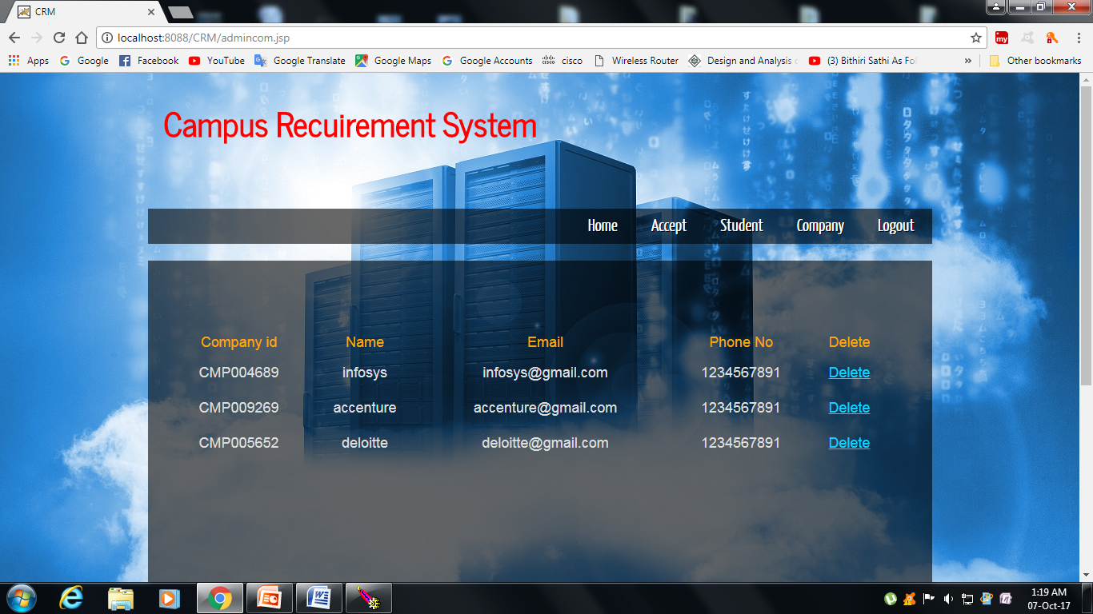
Admin company page:

Slide 23
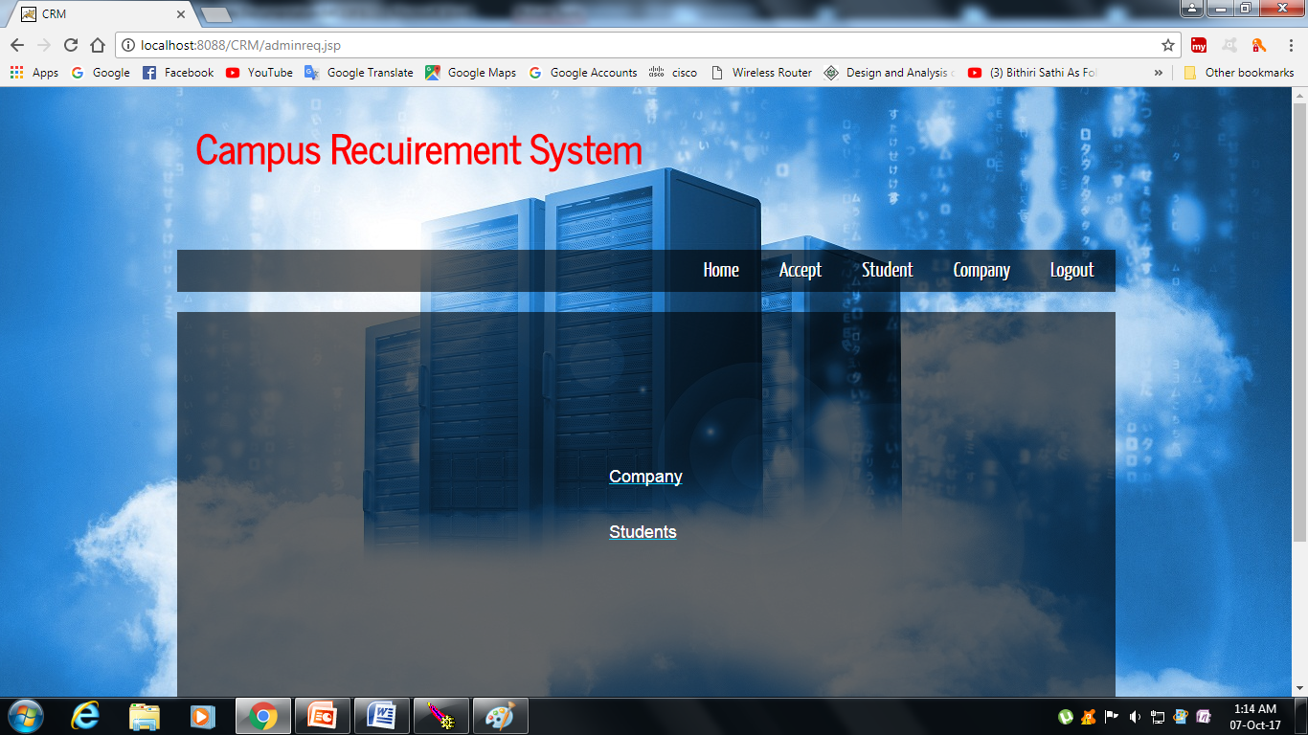
Admin accept page:

Slide 24


